Slide 1
Rainfall prediction using machine learning method
Submitted by -Chaity kundu

Slide 2
introduction
Climate of Bangladesh
The aim of this analysis was to forecast Bangladesh rainfall.
Bangladesh’s weather is unique from that of other countries due to fluctuations in rainfall, temperature, and relative humidity.
Summer, rainy season, and winter are the three main seasons in Bangladesh. Summer lasts from March to June, the rainy season lasts from June to October, and the winter season lasts from October to March.
Despite the fact that Bangladesh is known as a country with six seasons, these three are the most significant.

Slide 3
What is rainfall prediction
Rainfall is the most important component of the hydrological cycle, and it is the principal source of rainfall distribution that may have been used and regulated directly to meet consumption requirements.
Water is the most valuable natural resource that plays a significant role in social and economic development.
proper water planning and management are the main options for reducing water stress or closing the gap between supply and demand.
Numerous steps have been taken around the world to not only predict rainfall but also to establish the interaction between rainfall and runoff in order to alter water management procedures to make water accessible whenever it is needed

Slide 4
What is Machine Learning(ML) ?
Machine learning is a branch of artificial intelligence (AI) and computer science which focuses on the use of data and algorithms to imitate the way that humans learn, gradually improving its accuracy.
In my project I am using ML tools to give intelligence to our machine so that it can take decision automatically without participation of human being.

Slide 5
Dataset Overview
Dataset Size: The dataset used in this study consists of(2013-2022) average monthly temperature, rainfall, wind_speed, wind_dir, cloudy and windgust.
Data source: this dataset is collected from kaggle , which is a reliable dataset for meteorological data.
Preprocessing steps: before utilizing the dataset, various preprocessing techniques were applied , such as data merging to ensure data quality.
Data split: the dataset was divided into two categories training and testing sets, with a split ratio to train and evaluate the models effectively.

Slide 6
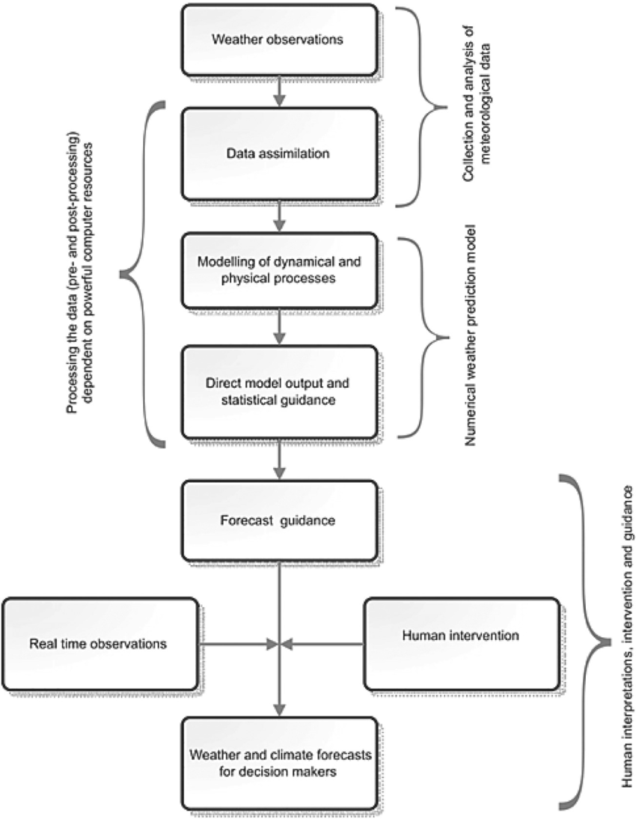
Methodology

Slide 7
The proposed model
Random forest: random forest algorithm is a supervised machine learning algorithm. It is a classifier that contains a numbers of decision trees on various subsets of the given dataset and takes the average to improve the predictive accuracy of the dataset.
It takes less learning time as compared other algorithm
It predicts with the high accuracy
It can also maintain accuracy when a large proportion of data is missing.

Slide 8
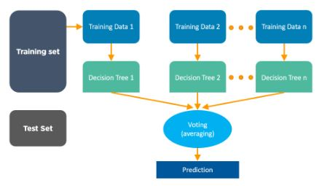
Work Flow

Slide 9
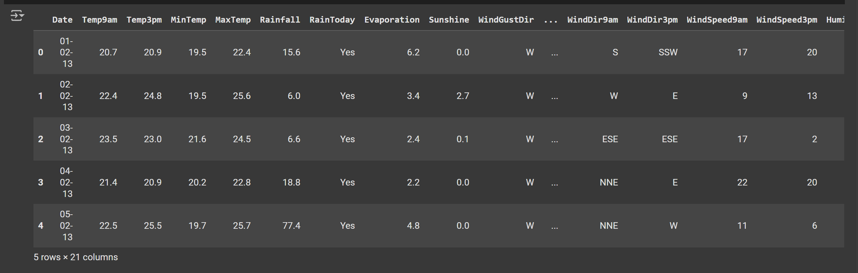
Dataset preview

Slide 10
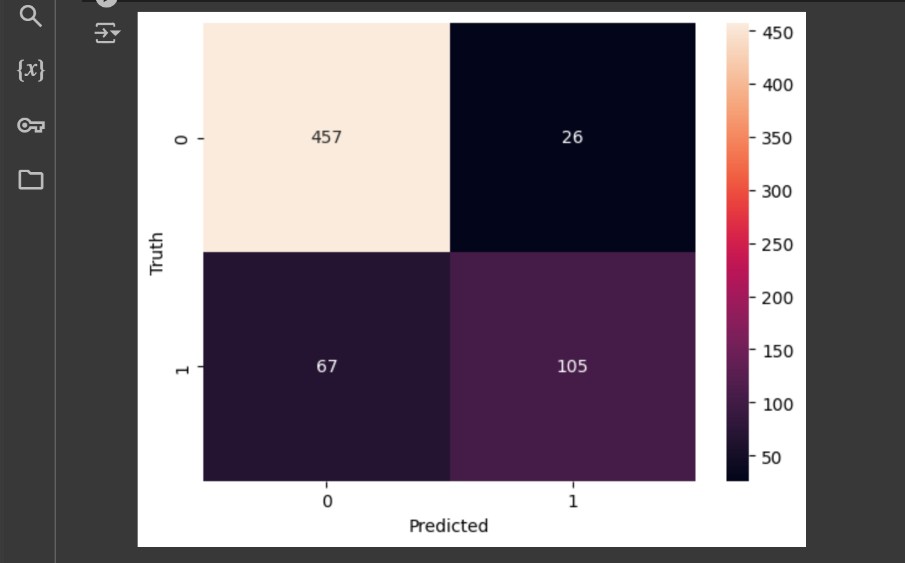

The proposed model’s Output
Random Forest

Slide 11
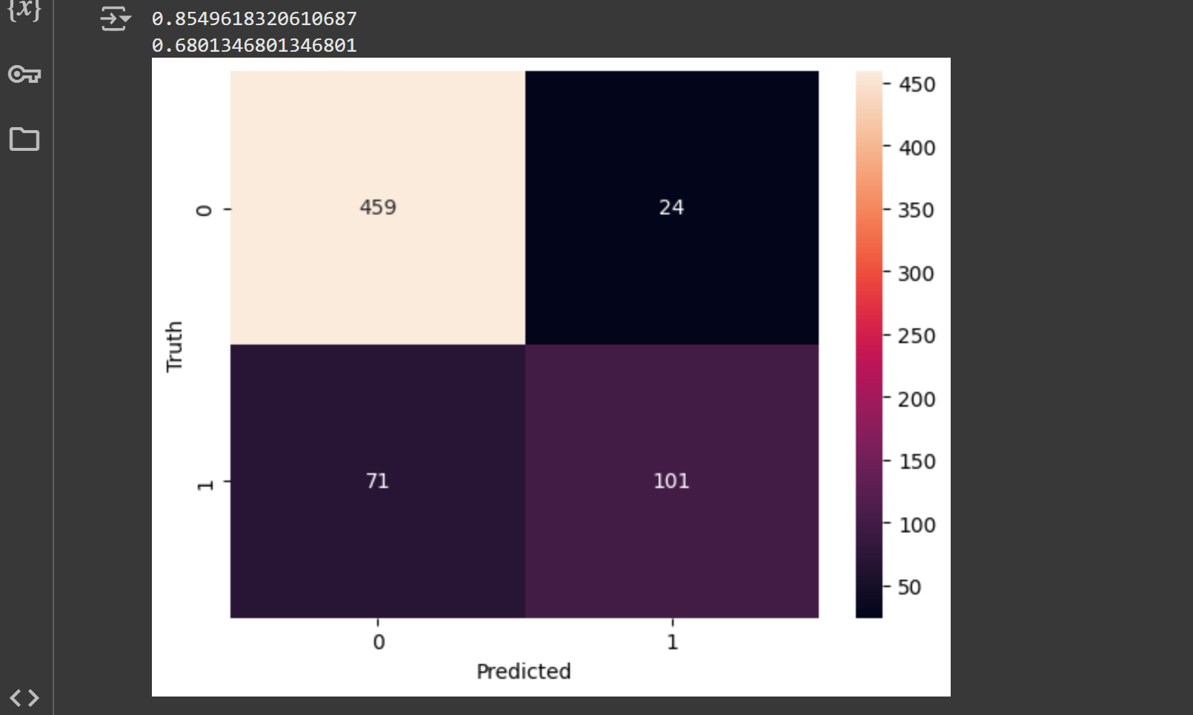
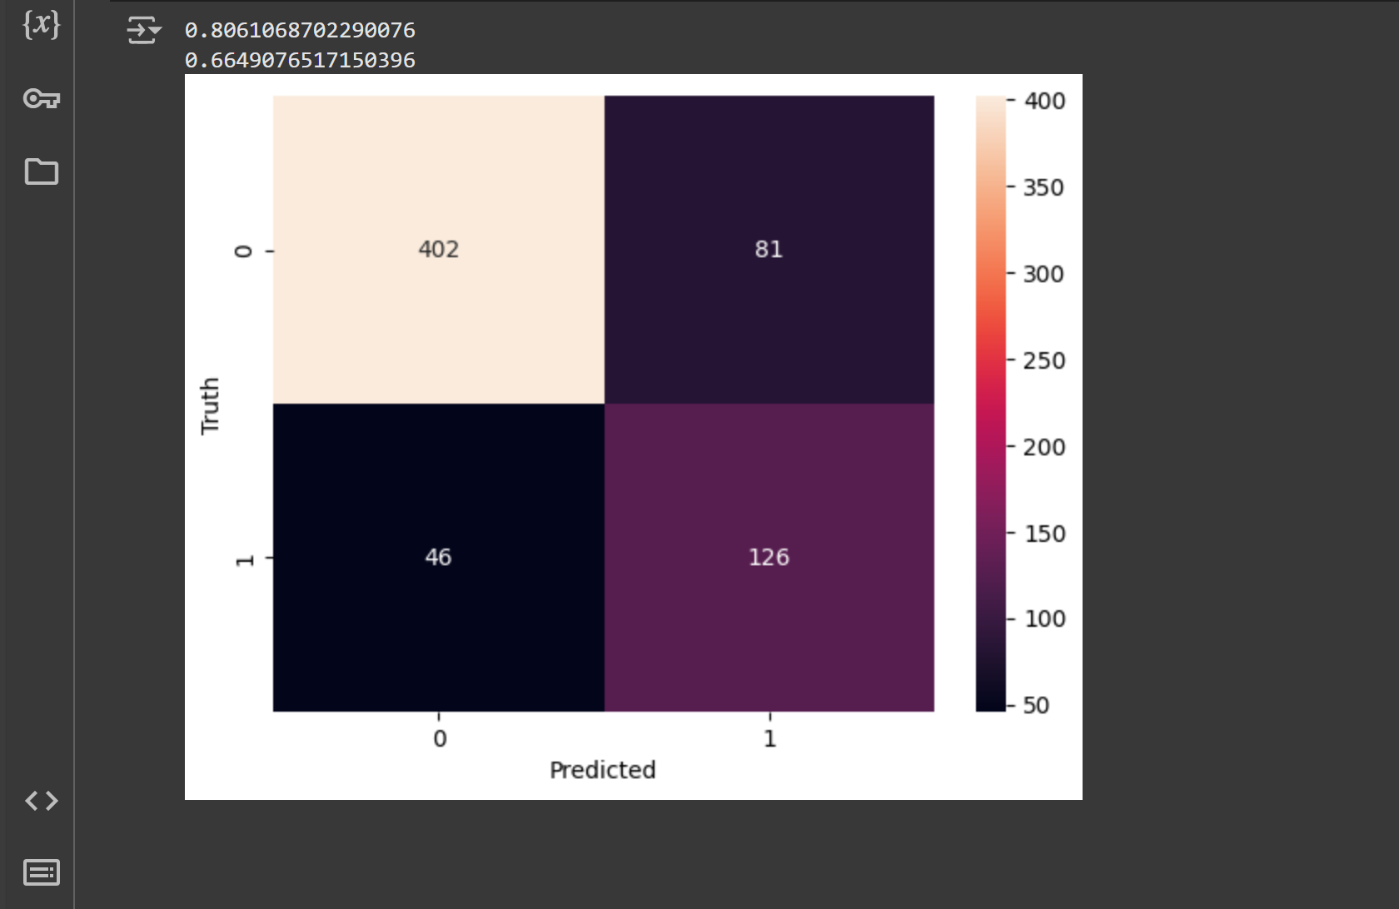
Here shown the output of SMV and Naïve Bayes Method
SVM
Naïve Bayes

Slide 12
Thank you

